Slide 1
NEA Testing & Evaluation

Slide 2
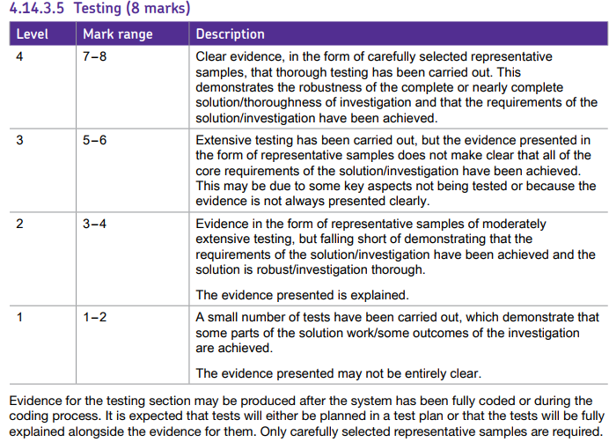
What the Mark Scheme Says

Slide 3
Test Strategy
You should include a test strategy which should outline what you will test and how you will test it in a generalised form.
It won’t include specific tests, but perhaps things like “I will ensure that my validation is working correctly by performing range tests, valid and invalid input tests. This will allow me to be confident that my system is working as expected and to ensure that the users cannot enter inputs that are not expected by the system.
Typically this will be several paragraphs long.

Slide 4
Guidance
You don’t need to test everything.
If it’s trivial, or not really contributing a major part to your project you don’t need to test it.
Have tests to prove you met all of your objectives individually.
You should prove it works for valid data and rejects invalid data for each objective.
Test for common crashes
E.g. No database file – what happens?
No network connection? – What happens?
Whole System Test
You should have one or more scenario tests which run through the entire system from start to finish to prove the system works as a whole, not just the parts.

Slide 5
Guidance (2)
Create a Test Plan
It should be numbered, outline the purpose of the test, any test data used, the expected outcome and the actual outcome.
Screenshot based testing needs to have annotation and explanation of the screenshots. Not recommended, takes too long.
Video testing needs either a spoken voice over, or an annotated timeline with explanations. Voice-over video testing good. Reccomended.
If something doesn’t work as it should, include it, fix it and re-test it.
There is no requirement to have any failed tests, however in reality I like to see at least 1 to show how you respond and adapt.
Any screenshot, or video must be clear and not need to be zoomed in - screenshots will be printed and so not able to be zoomed.
For videos you can upload to Youtube (unlisted), or if you want to password protect it then Vimeo will allow you to upload a 500mb video and password protect it. Use URL shortener to make URL easier to copy.
Make sure you include the URL and password (if needed) in your documentation.

Slide 6
Video Testing
You should aim to test your project by recording it. This allows you to do far more extensive testing far faster than doing a 100+ pages of screenshots.
Your video should ideally be voiced-over but if not at least edited to put captions on to explain what is going on.
You need to produce a test plan, put the URL to your video which must stay live until at least results day
In your test plan you need to record what you are testing, what test data you are using and the expected and actual outcome “it works” is not acceptable.
You should also have an “Evidence” column, this will contain a referenced link to a screenshot or the timestamp from the video providing proof.
You also need to have a full “run through” from start to finish of your project working in the realistic usage scenario.
https://www.youtube.com/watch?v=xOaTj2JQ9j0&list=PL4vkQSepb6WPkQ7fl0SaygJ1Qj7RKtTz5&index=23
https://www.youtube.com/watch?v=YaMO_Tf2eD0&list=PL4vkQSepb6WPkQ7fl0SaygJ1Qj7RKtTz5&index=13

Slide 7
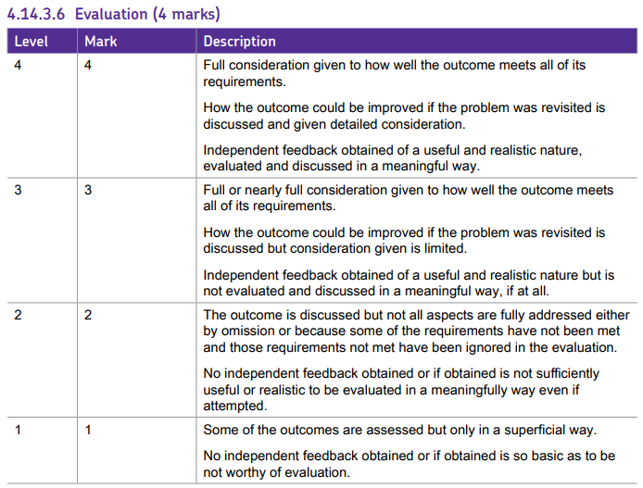
Evaluation

Slide 8
Guidance
Have you met your objectives?
For each objective list how you met it, the impact meeting it has on the overall system and link to the tests which prove you met it.
What would you do differently or add to your project with more time?
Again you should not only consider the idea, but also the impact this improvement will have on the overall quality of the project.
Get independent feedback!
Without feedback from your ‘client’ or ‘users’ then you are highly limited in the marks you can get.
This feedback should be evaluated so ideally surveys or questionnaires which give quantifiable data will be useful.
Discuss the feedback, any improvements it might lead to and justification as to why they would be an improvement or why they may not have been done yet.

